Slide 1
SFWR TECH 4DA3
Linear Discriminant Analysis
Instructor: Dr. Jeff Fortuna, B. Eng, M. Eng, PhD, (Electrical Engineering), McMaster University
email: fortunjj@mcmaster.ca

Slide 2
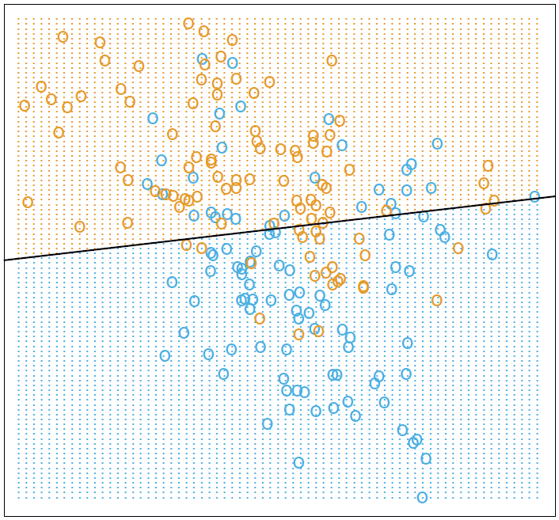
The Classification Problem
Assume that we collect weight and height data of male and female subjects.
We will use this data as training data to devise an approach to predict whether a subject is male or female given only their weight and height.
More specifically, we will try to find a LINE (with 2 attributes or a plane with 3 attributes or a hyperplane with more than 3 attributes) that separates the training data into two classes.
We will then use this line, plane or hyperplane to predict which class an unknown data point falls into.
This approach is called Linear Discriminant Analysis
Weight
Height

Slide 3
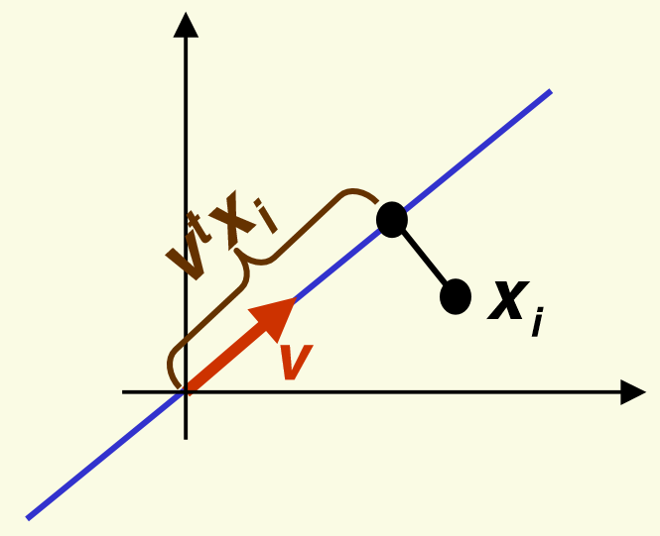
The Idea of LDA
Project the data points onto the line, plane or hyperplane and obtain distances between points along the line, plane or hyperplane.
We will use these distances to create a discriminant
To do this we will use one simple geometric idea:

Slide 4
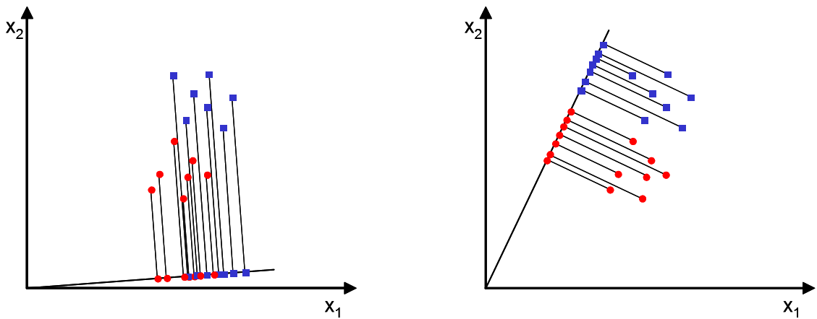

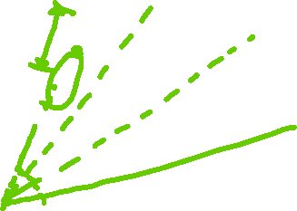
Which line?
Of all possible lines we would like to select the one that maximizes the separability of the points on the line. Clearly, that is picture 2 above.

Slide 5
Finding the line
From this point on, I will talk about a line. But there is no difference in the math when it is a plane or hyperplane. The only thing that changes is the dimensionality of x and w
In order to find a good projection vector, we need to define a measure of separation between the projections.
In general, what we will try to do is maximize the distances between the classes

Slide 6
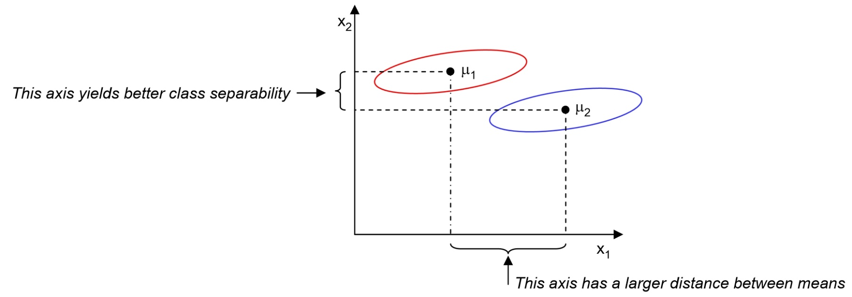

Distance between class means
One option is to simply use the distance between the projected class means as an objective to maximize…
But this isn’t a good measure since it doesn’t take the standard deviation of the classes into account:

Slide 7

Fisher’s Linear Discriminant
The solution proposed by Fisher is to maximize a function that represents the difference between the means, normalized by a measure of the within-class scatter (variance).

Slide 8
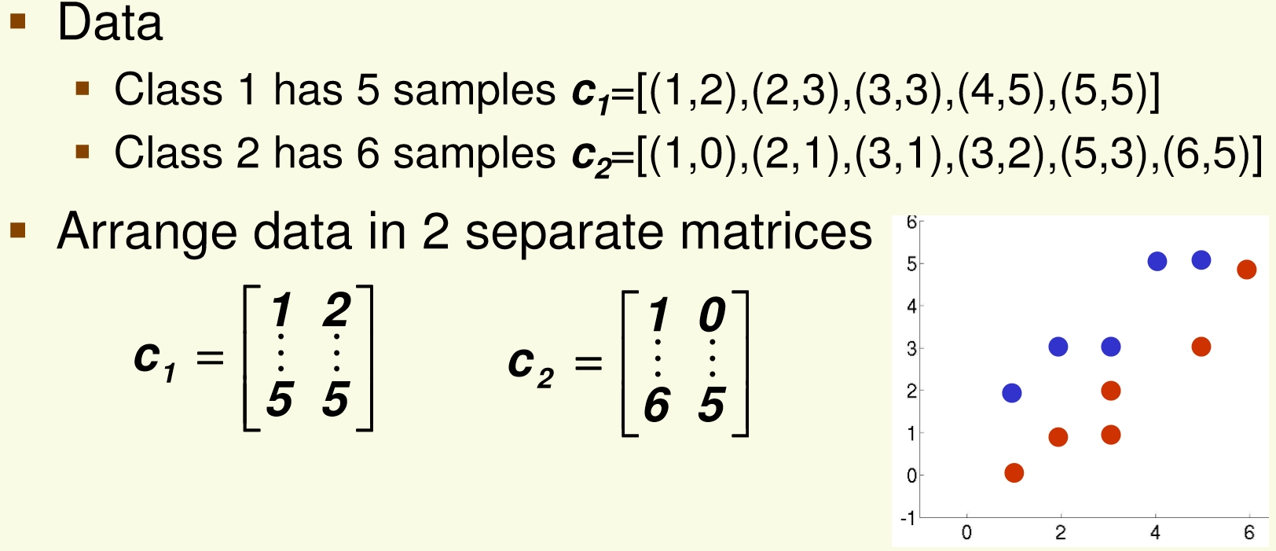
An example using Excel

Slide 9
Last step…compute the discriminant function value

